Slide 1
Estimators in dynamic systems

Slide 2
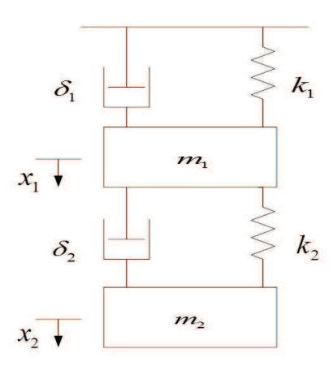
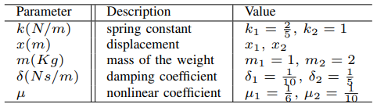
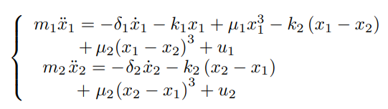
Nonlinear system

Slide 3
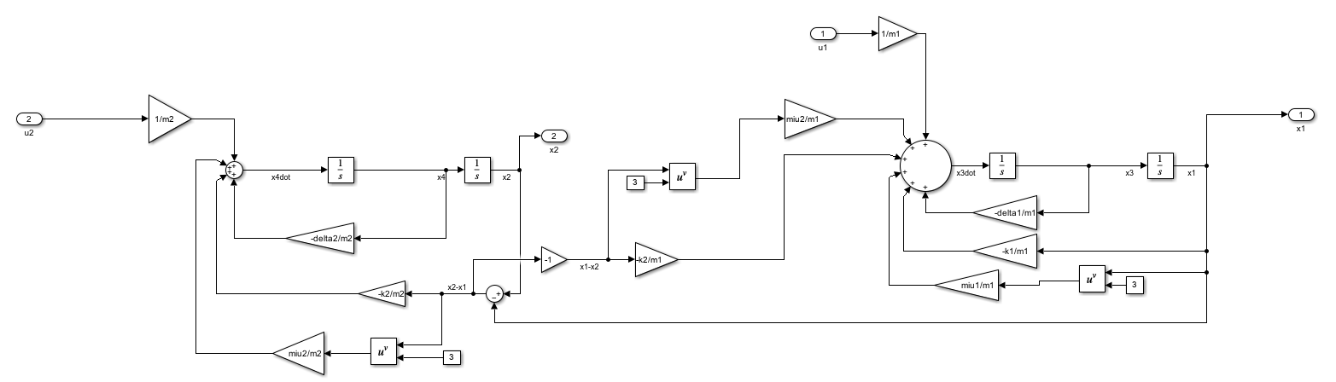
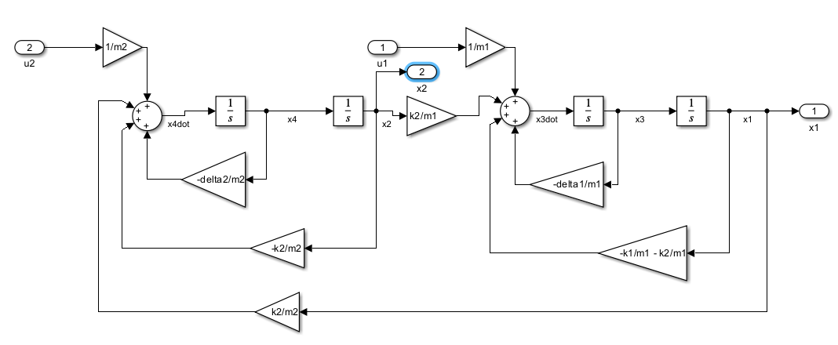
Nonlinear system vs linearized system

Slide 4
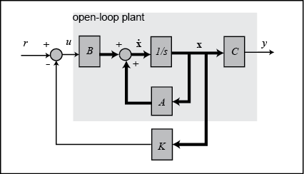
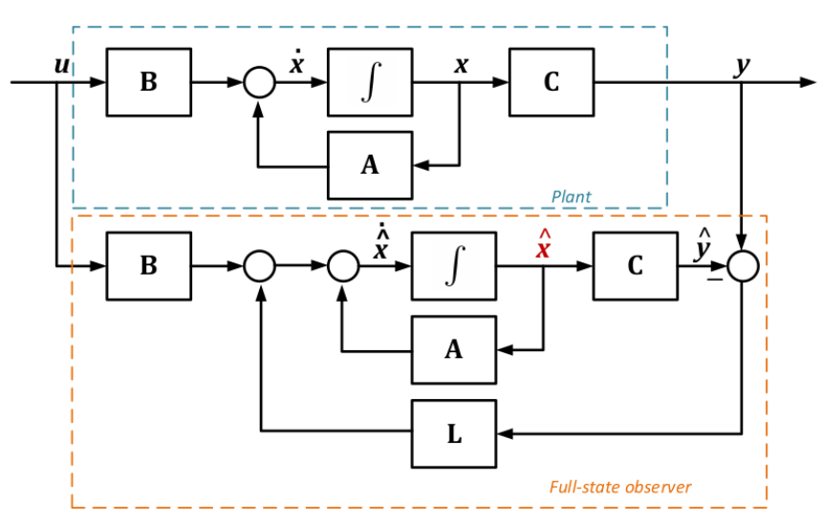
State feedback and observer
The state feedback control and the observer are designed using the linearized system which is controllable and observable
K=place(A,B,[-3,-3,-4,-4]);
L=place(A',C',[-10,-10,-20,-20])’;
The poles of the closed loop system have to be in the left half plane
state feedback control

Slide 5
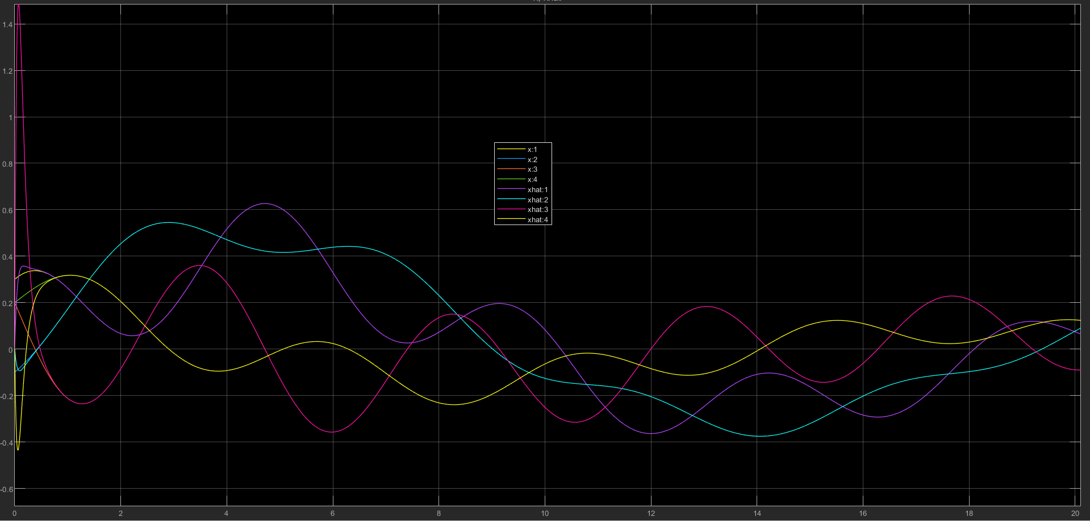
estimation

Slide 6
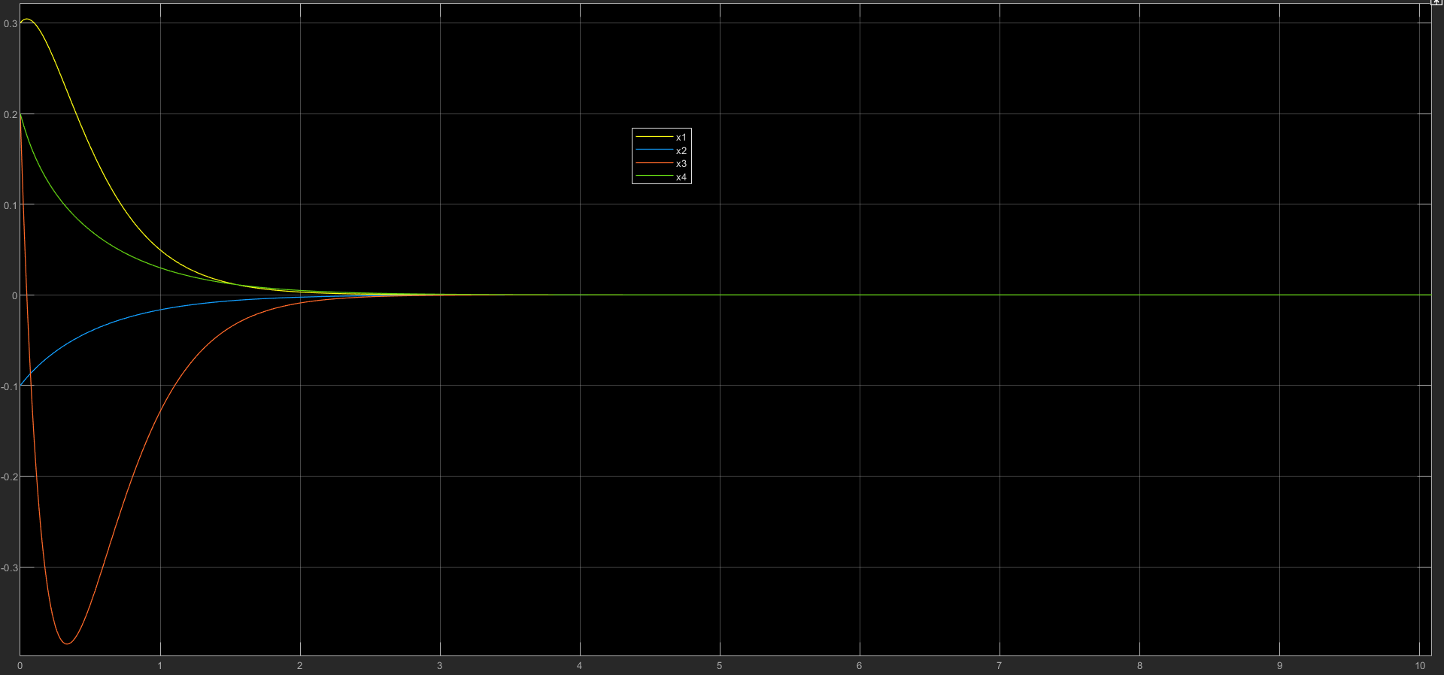
Control

Slide 7
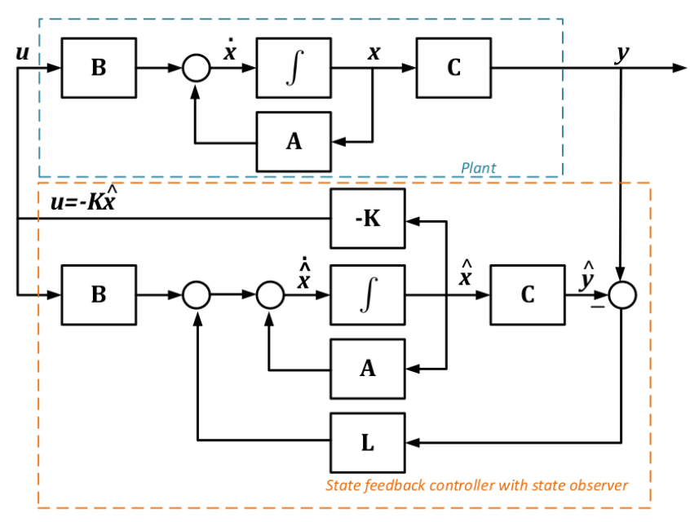
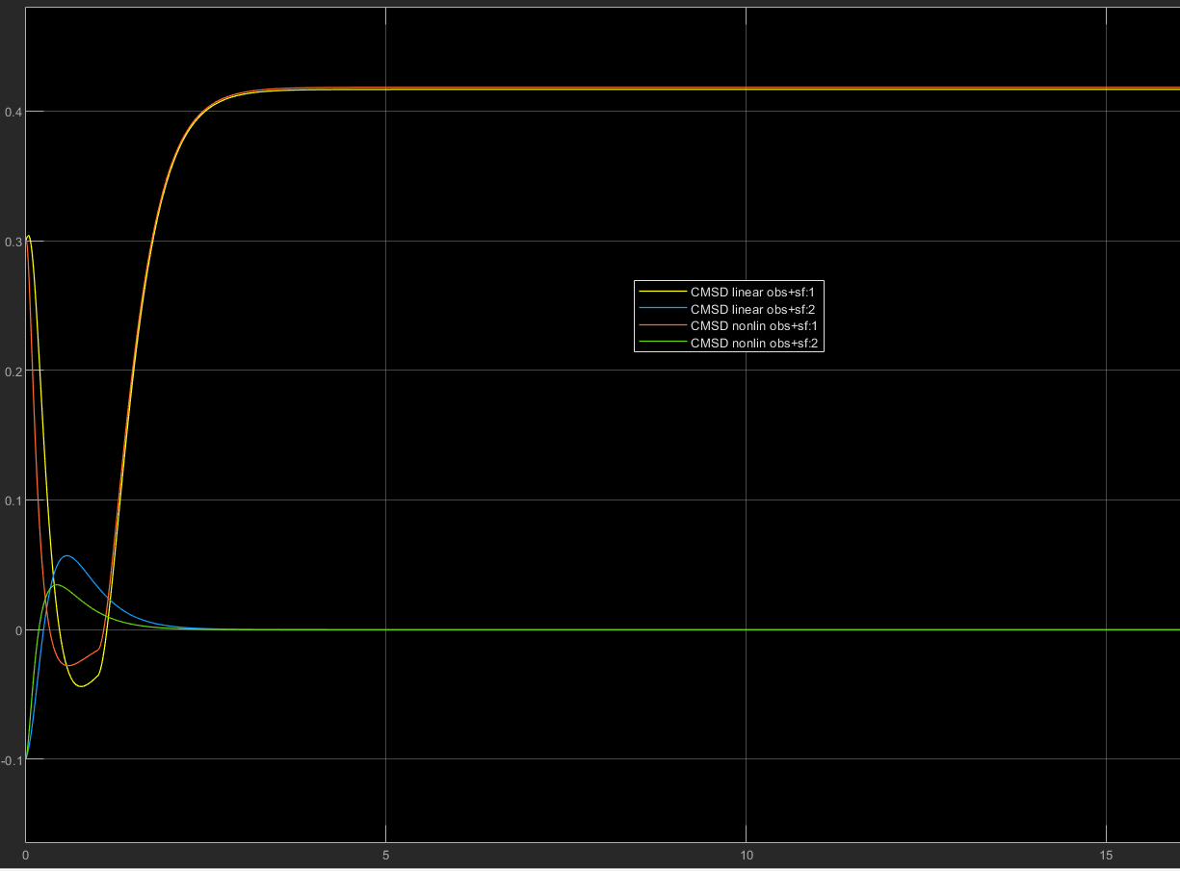
State feedback using observer

Slide 8
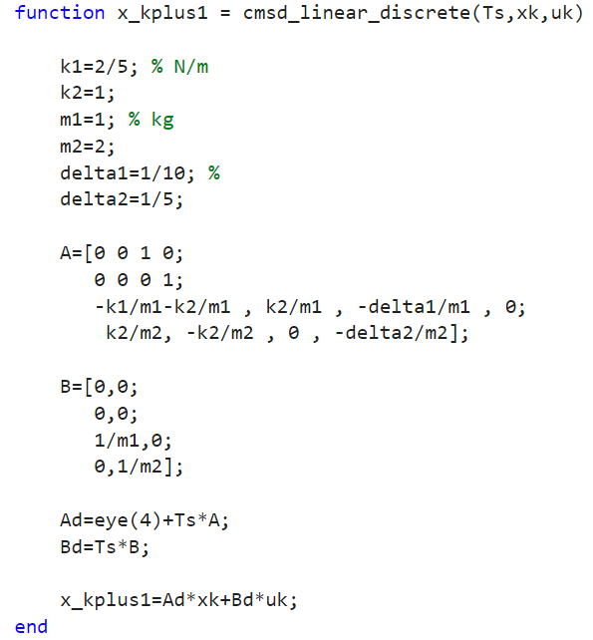
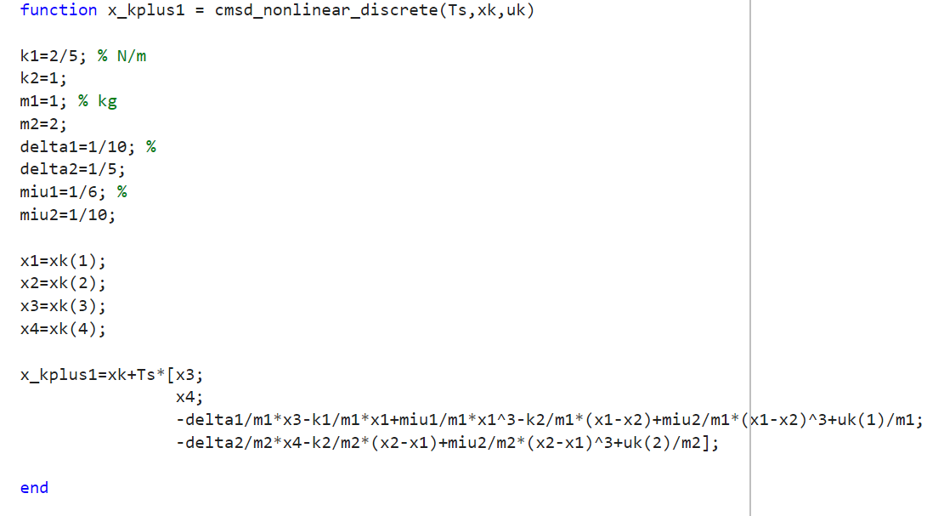
Discrete systems

Slide 9
Discrete State feedback control and observer
We design again the state feedback control and the observer
This time, though, the poles of the closed loop system have to be in the unit circle for stability
Ts=0.01;
Kd=place(Ad,Bd,[exp(-3*Ts),exp(-3*Ts),exp(-4*Ts),exp(-4*Ts)]);
Ld=place(Ad',C',[exp(-10*Ts),exp(-10*Ts),exp(-20*Ts),exp(-20*Ts)])’;
The old poles are mapped to the unit circle using z=exp(-s * Ts)

Slide 10
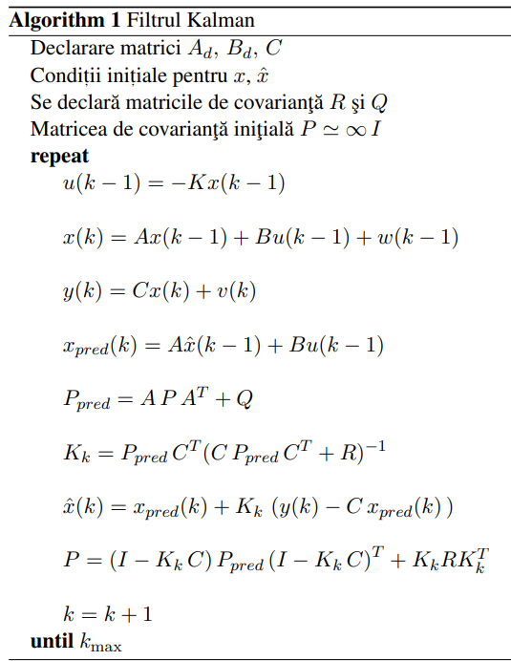
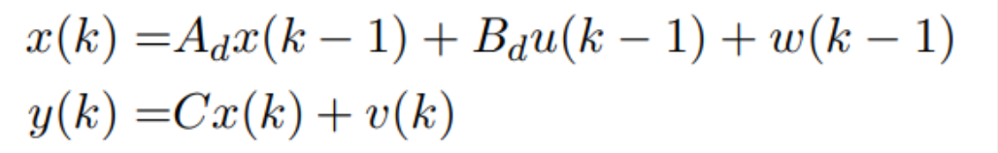
Kalman filter
dynamics:
v and w are white noise signals
w~Q
v~R

Slide 11
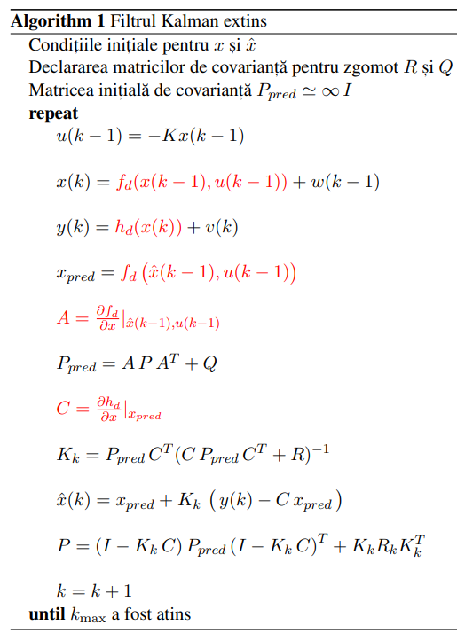
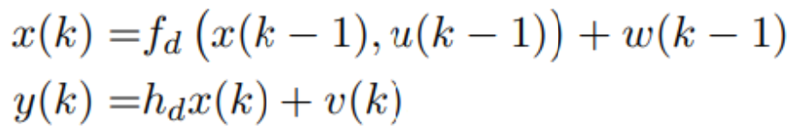
Extended kalman filter
dynamics:

Slide 12
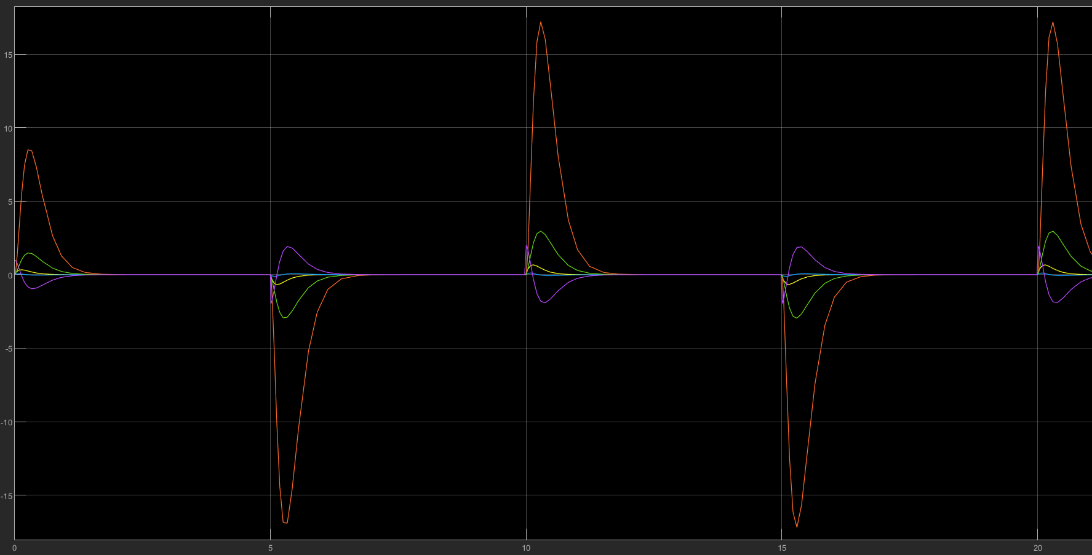
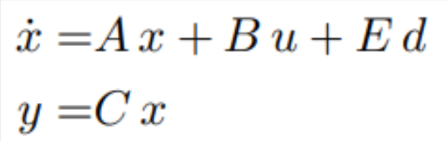
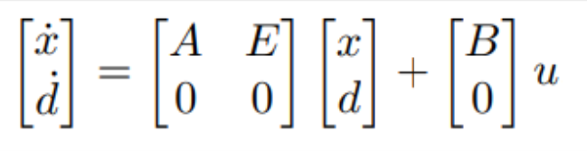
Unknown input observer
estimate error of the 4 states, when applying a square signal as unknown input
initial system:
extended system:

Slide 13
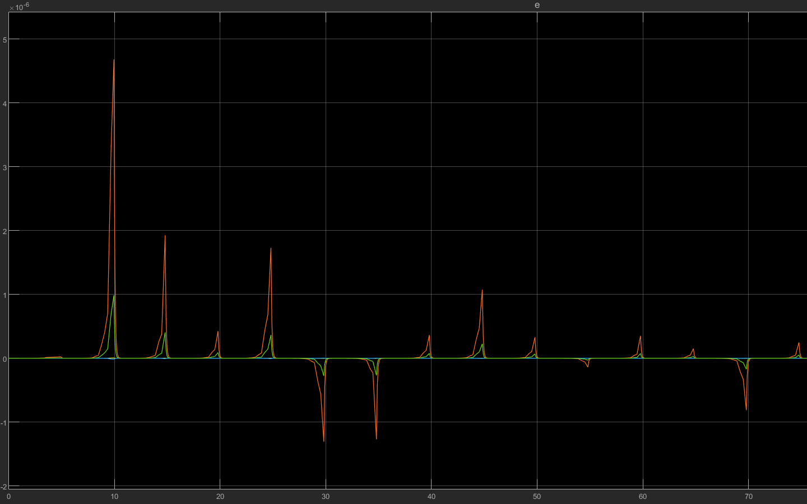
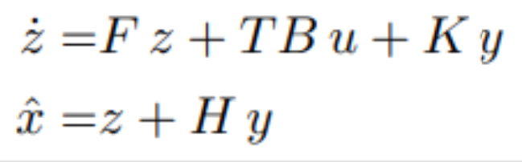
unknown input decoupling observer
estimate error of the 4 states, when applying a square signal as unknown input
Observer form:

